Slide 1
House Price Prediction Model
Coursework Assignment of Applied Machine Learning
By Rajita Maharjan

Slide 2
Introduction to the Project of House Price Prediction Model
The objective is to predict house prices using a machine-learning technique.
The price of a house depends on its location, size, and age, among other features.
The model allows stakeholders in the property market to predict the appropriate selling price for their houses.

Slide 3
Machine Learning Concepts
Machine learning is the capability to learn through experience and make accurate predictions on data.
Techniques Used: Linear Regression, Decision Tree, Random Forest

Slide 4
Research and Dataset
The dataset is available from Kaggle, which has the following features that helped predict house prices: number of rooms, location, size, amenities.

Slide 5
Solution and Development
Data Collection: Collecting data about houses.
Data Preprocesing: Cleaning data, categorical encoding, numerical scaling.
Feature Selection: Identifying features directly impacting house prices.
Model Selection: Linear Regression, Decision Tree, Random Forest.
Model Training: Train the model with a train-test division of data.
Model Evaluation: Evaluate using MSE and R² Score metrics.
Model Deployment and Maintenance: Deploy the model for newer predictions and keep it updated.

Slide 6
Pseudocode and Flowchart
Pseudocode:Load data and clean.
Encode categorical variables.
Scale numerical features.
Split the data into training and testing sets.
Train models: Linear Regression, Decision Tree, Random Forest.
Evaluate models using MSE and R² Score.
Select the best model.
Output performance and plot results

Slide 7
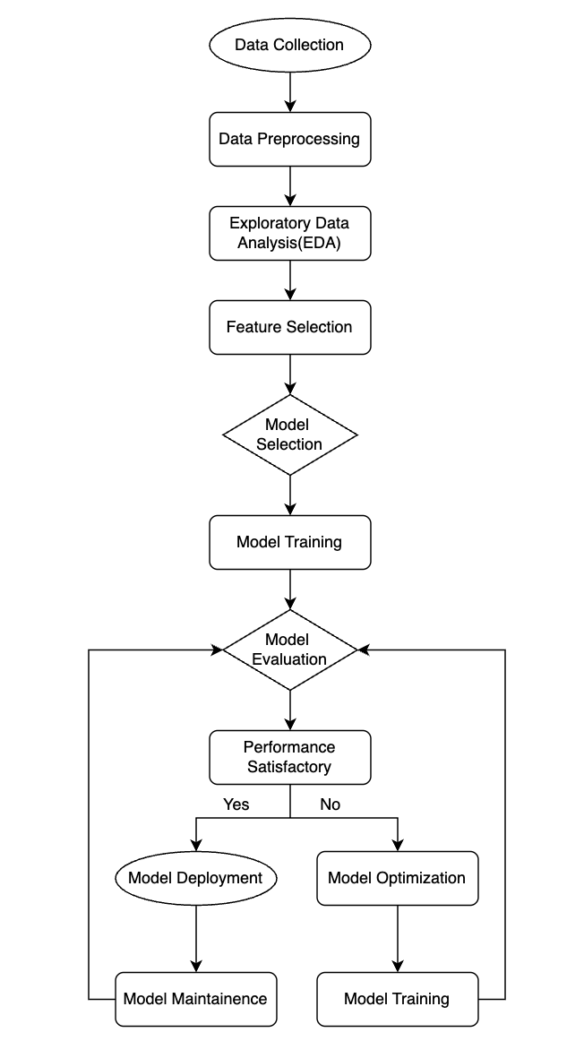
Flowchart of the solution

Slide 8
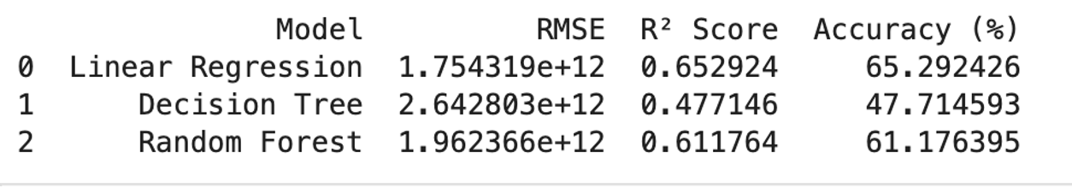
Overview of Results
Linear Regression:
RMSE: 1,754,319,000,000
R² Score: 0.653
Accuracy: 65.29%
Tuned Decision Tree:
RMSE: 2,903,251,000,000
R² Score: 0.425
Accuracy: 47.71%
Random Forest:
RMSE: 1,962,366,000,000
R² Score: 0.612
Accuracy: 61.18%

Slide 9
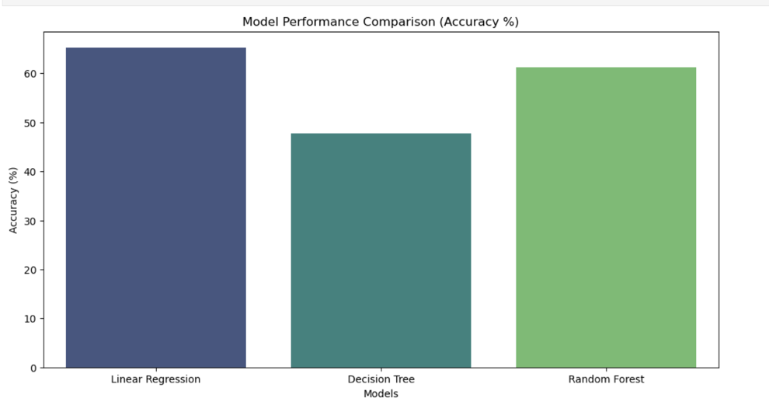
Graphs

Slide 10
Addressing Real-World Problems
Title: Addressing Real-World Problems
Buyers: Helps in deciding what a fair price for a house is.
Sellers: Consistently sets competitive prices.
Agents: Advice based on available data.
Banks: Manages data for property valuations against loans.
Investors: Helps in decision-making for investment.

Slide 11
Conclusion and Future Work
Summary: The top performance was provided by Linear Regression with Random Forests.
Future Work:
Enhance feature engineering capabilities.
Collect more data.
Experiment with better and bigger models like Gradient Boosting and Neural Networks.

Slide 12
Thank You Any Questions?

